Slide 1
KISAN BUDDY MAHINDRA FARMEQ
PIP2001 Capstone Project
Review-1
Batch Number:205
Under the Supervision of,
Dr . ABDUL KHADAR A
Associate Professor
School of Computer Science and Engineering
Presidency University
Roll Number | Student Name
20211CSE0884 | KAKARLA MANOJ KUMAR
20211CSE0164 | ALLURU SIVA SAHITHI
20221LCS0005 | SHREYANK S
Name of the Program: Name of the HoD: DR.ASIF MOHAMMED H.B
Name of the HOD:DR.ASIF MOHAMMED H.B
Name of the Program Project Coordinator: MR.AMARNATH J.L
Name of the School Project Coordinators: Dr. Sampath A K / Dr. Abdul Khadar A / Mr. Md Ziaur Rahman

Slide 2
Introduction
Agriculture remains the backbone of many economies, especially in rural areas where farmers rely on traditional methods to sell their produce. However, these conventional systems are often plagued by inefficiencies, including limited market access, communication barriers between farmers and mandi shops, and delayed payments. The growing need to modernize and streamline agricultural transactions has prompted the development of digital solutions that empower farmers with direct access to markets and better control over their produce sales.
This Android application seeks to bridge the gap between farmers and mandi shops by offering a comprehensive platform that facilitates seamless communication and transactions. The app is designed with three core modules—Admin, Mandi Shops, and Farmer each tailored to meet the specific needs of the respective users. Farmers can easily register, log in, submit requests for selling produce, view their transaction history, and make payments. Mandi shops can log in, view and update requests, manage costs, and track the status of transactions, while the Admin module ensures efficient oversight of mandi shops and farmers.

Slide 3
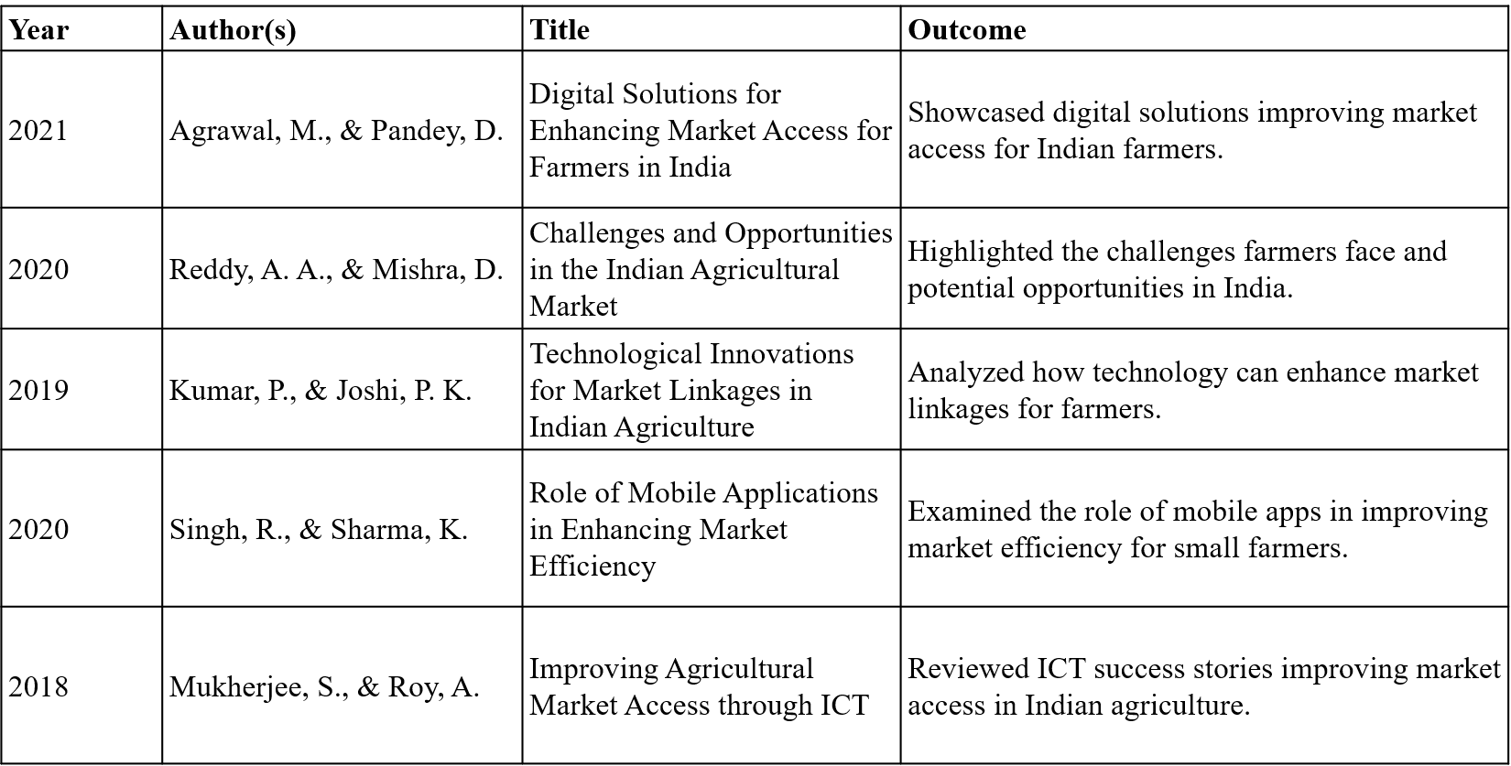
Literature Review

Slide 4
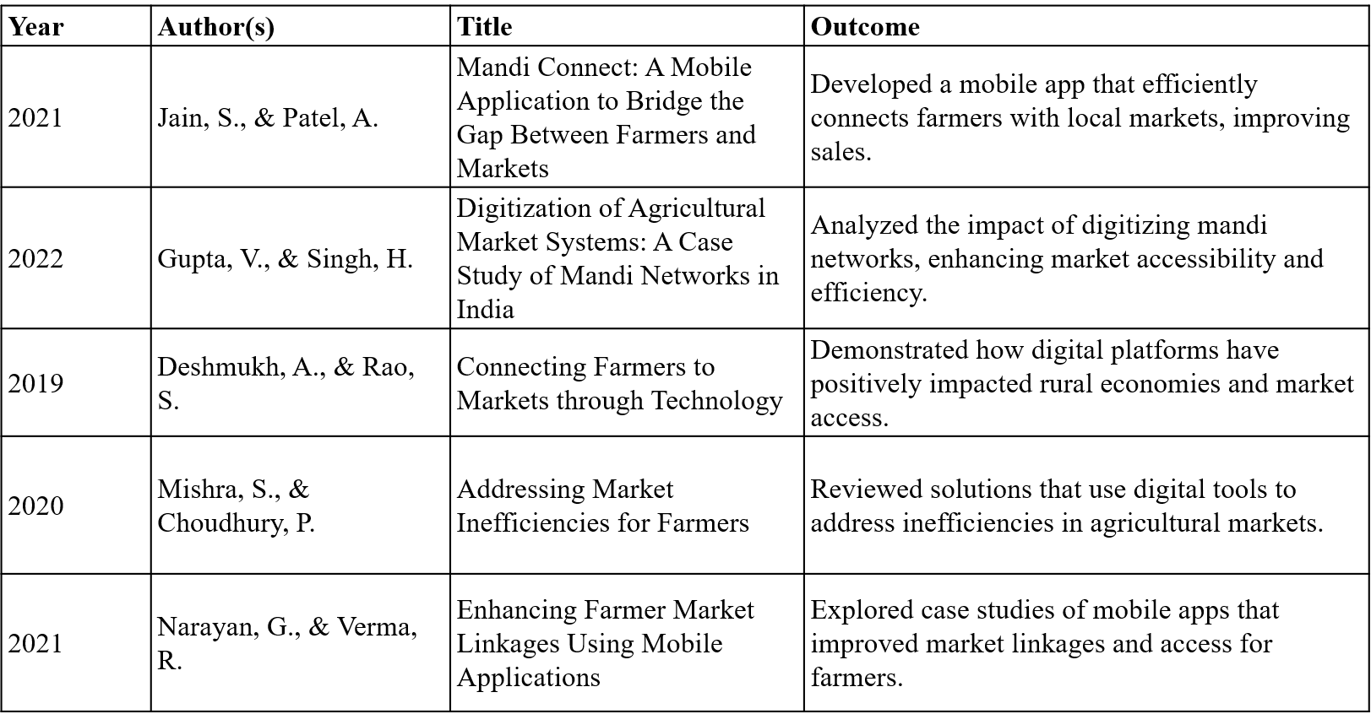
Literature Review

Slide 5
Existing Method Drawback
In the existing manual process, farmers typically visit nearby mandi shops or markets to sell their produce. This system relies heavily on in-person communication, where farmers negotiate prices directly with shop owners. There is limited transparency in transactions, leading to delays in payments. Additionally, farmers may face challenges in finding the best markets for their produce, as the system lacks an organized structure for tracking requests, updating prices, or managing sales efficiently.

Slide 6
Disadvantages
The manual process offers limited visibility into transactions, making it difficult for farmers to track payments and the status of their produce.
Farmers must visit markets in person, leading to time-consuming negotiations and delayed responses from mandi shops.
Without a structured system, farmers may struggle to identify the best markets for their produce, reducing their opportunities for better pricing and sales.

Slide 7
Purpose Method
The Android application is built with three key modules: Admin, Mandi Shops, and Farmers. The Admin module allows administrators to log in, manage mandi shops, and view farmers. The Mandi Shops module enables shop owners to log in, view farmer requests, update produce costs, and manage request statuses. The Farmer module allows farmers to register, log in, submit requests for selling produce, view transaction history, and make payments. The system integrates location services to ensure farmers connect with the nearest mandi shops, promoting efficient market interactions..

Slide 8
Advantages
The app provides an intuitive and easy-to-use platform for farmers, mandi shops, and administrators, ensuring smooth navigation and interaction.
By utilizing location services, farmers can easily connect with the nearest mandi shops, ensuring better market accessibility.
Farmers can track the status of their requests and payments, fostering transparency in transactions with mandi shops.
The app enables real-time communication between farmers and mandi shops, streamlining the process of selling produce and updating costs.

Slide 9
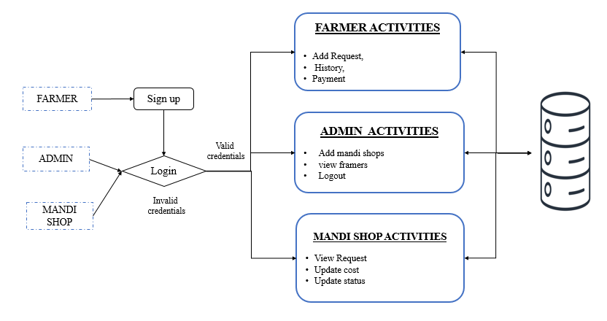
Architecture

Slide 10
Hardware/Software Components
SOFTWARE REQUIREMENS
Operating System - Windows 10
JDK - java(koltin)
SDK - Android
IDE -Android studio
Database` - my SQL
HARDWARE REQUIREMENTS
Processor - I3/Intel Processor
RAM - 8 GB
Hard Disk - 1TB

Slide 11
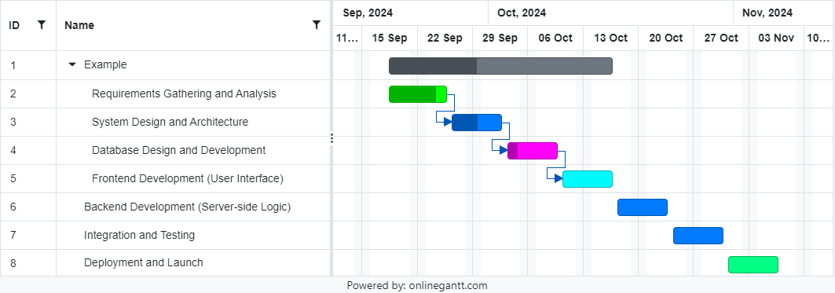
Timeline of Project

Slide 12
Expected Outcomes
The expected outcome of the Android application is to create an efficient and transparent platform that connects farmers with mandi shops, enhancing communication and market access. The app will simplify the process of selling produce, enabling farmers to submit requests, view transaction history, and receive timely payments. Mandi shops will be able to manage requests, update prices, and track transactions more effectively. By providing a digital solution, the platform aims to improve market efficiency, ensure fair pricing for farmers, and promote faster, more secure transactions, ultimately improving the livelihoods of farmers and streamlining the agricultural supply chain.

Slide 13
Conclusion
The Android application designed to connect farmers with mandi shops effectively addresses the inefficiencies of the traditional agricultural market system. By offering a digital platform that enhances communication, transparency, and real-time updates, the app simplifies the process of selling agricultural produce. The integration of location services ensures that farmers are connected with the nearest mandi shops, promoting market accessibility. The platform not only streamlines transactions, resulting in timely payments, but also empowers farmers with better control over their produce sales. Ultimately, this solution improves the agricultural supply chain and contributes to the financial stability of farmers.

Slide 14
Github Link
https://github.com/Manoj28012003/kissan-Buddy

Slide 15
References
Agrawal, M., & Pandey, D. (2021). "Digital Solutions for Enhancing Market Access for Farmers in India." Journal of Agricultural Sciences and Technology, 10(2), 150-160.
Reddy, A. A., & Mishra, D. (2020). "Challenges and Opportunities in the Indian Agricultural Market: A Farmer's Perspective." Agricultural Economics Review, 25(3), 120-132.
Kumar, P., & Joshi, P. K. (2019). "Technological Innovations for Market Linkages in Indian Agriculture." Agriculture and Food Security Journal, 8(1), 45-53.
Singh, R., & Sharma, K. (2020). "Role of Mobile Applications in Enhancing Market Efficiency for Small Farmers." International Journal of Agricultural Extension, 17(2), 95-108.
Mukherjee, S., & Roy, A. (2018). "Improving Agricultural Market Access through ICT: A Review of Success Stories in India." Journal of Rural Development Studies, 14(2), 234-247.

Slide 16
References
Jain, S., & Patel, A. (2021). "Mandi Connect: A Mobile Application to Bridge the Gap Between Farmers and Markets." International Journal of Digital Transformation, 5(4), 102-112.
Gupta, V., & Singh, H. (2022). "Digitization of Agricultural Market Systems: A Case Study of Mandi Networks in India." Journal of Applied Agricultural Research, 9(1), 77-89.
Deshmukh, A., & Rao, S. (2019). "Connecting Farmers to Markets through Technology: The Impact of Digital Platforms on Rural Economies." Rural Development Journal, 12(3), 163-174.
Mishra, S., & Choudhury, P. (2020). "Addressing Market Inefficiencies for Farmers: A Review of Digital Agricultural Solutions." International Journal of Agribusiness Studies, 18(2), 112-122.
Narayan, G., & Verma, R. (2021). "Enhancing Farmer Market Linkages Using Mobile Applications: A Review of Case Studies in India." Journal of Agricultural Economics and Development, 10(4), 182-194.

Slide 17

Project work mapping with SDG

Slide 18
THANK YOU

